Slide 1
Software Innovation Studio
Team
Graphics created by Ullupta conecum re volupta evelignis pe et doluptuam.

Slide 2
The targeted market
                Introduce the targeted market with clear references (survey, news, daily life, research paper, book, and anywhere …)
                How large and the trend to the selected market
                The same/similar ideas, products or solutions in the current market
                => Highlight the missing or gap(s)

Slide 3


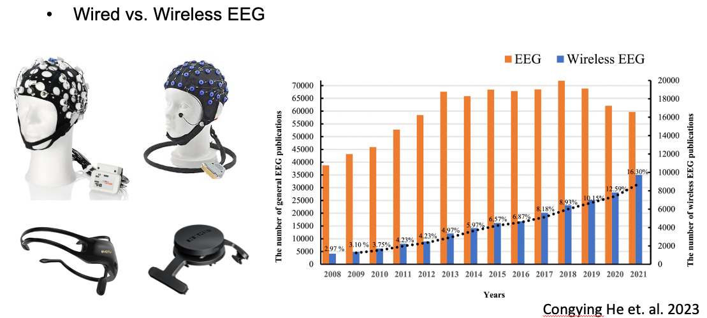
The targeted market

Slide 4
Case Study
Select one software/project/solution which is the biggest competitor in the selected/defined market
Introduce details about the case with key insights
Hint: You may have figure(s)/video(s)

Slide 5
Case Study – Function 1
Introduce and/or demo the first killer/unique function(s)
Cover insights and design logic behind the function
Please do function analysis (empathise, define, Ideate; same as
design thinking) + suggestions/comments
Demo it
Hint: You may have figure(s)/videos/real-time demo

Slide 6
Case Study – Function 2
Introduce and/or demo the second killer/unique function(s)
Cover insights and design logic behind the function
Please do function analysis (empathise, define, Ideate; same as
design thinking) + suggestions/comments
Demo it
Hint: You may have figure(s)/videos/real-time demo

Slide 7
Thank you

